Slide 1



Free VPN Presentation
Ben Sottile

Slide 2
Free VPNs I Selected
I picked these because the came up a lot in my seaches for free VPNs so I believed they were worth testing.
Proton VPN
Hotspot Sheild
Hide.me

Slide 3
Proton VPN Free
Unlimited Data Usage
Three server locations in US, Japan and the Netherlands.
clients for Windows, Mac, Android ,and iPhone.
Interesting features like split tunneling and DNS leak protection are included free.
Speed throttling paying customers get more priority- Don’t Even thing of trying to stream
Pretty Great

Slide 4
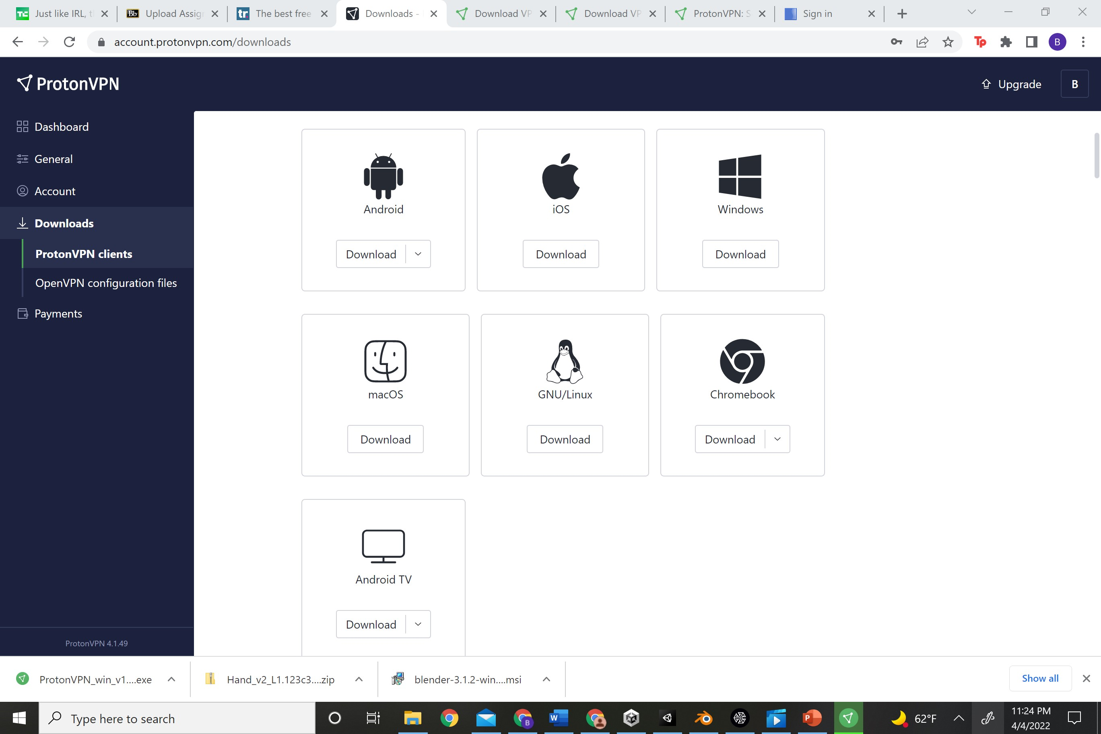
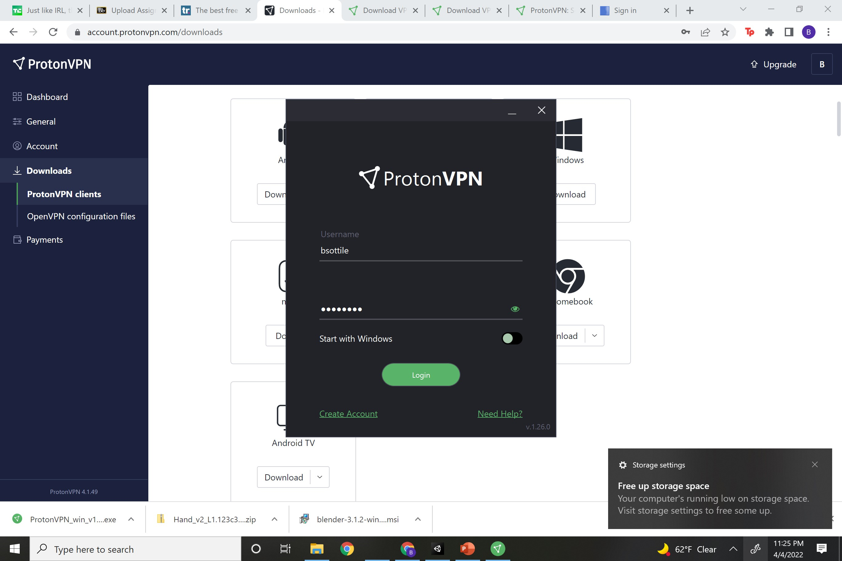
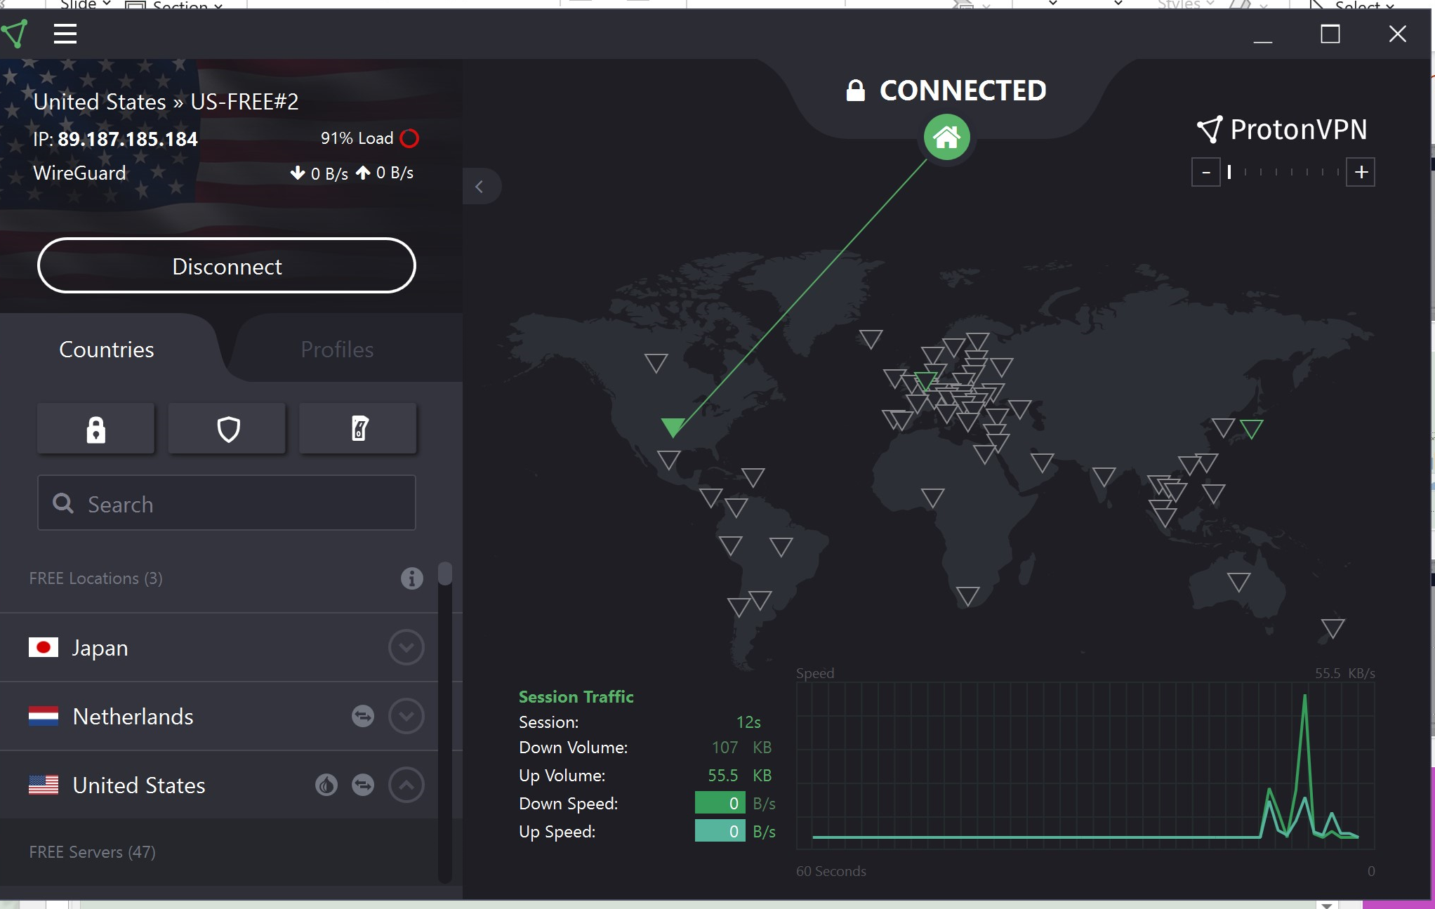
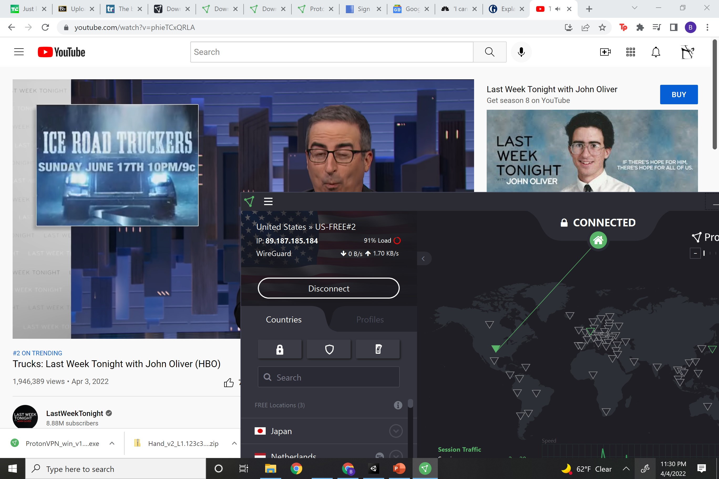
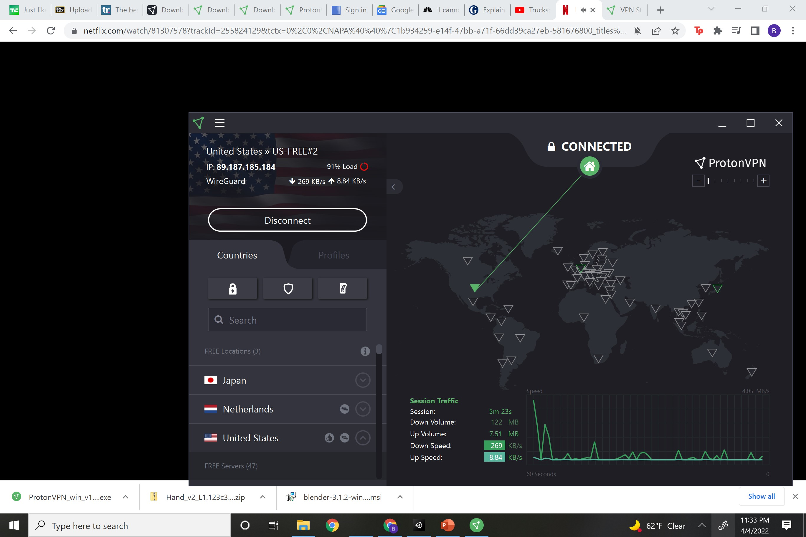
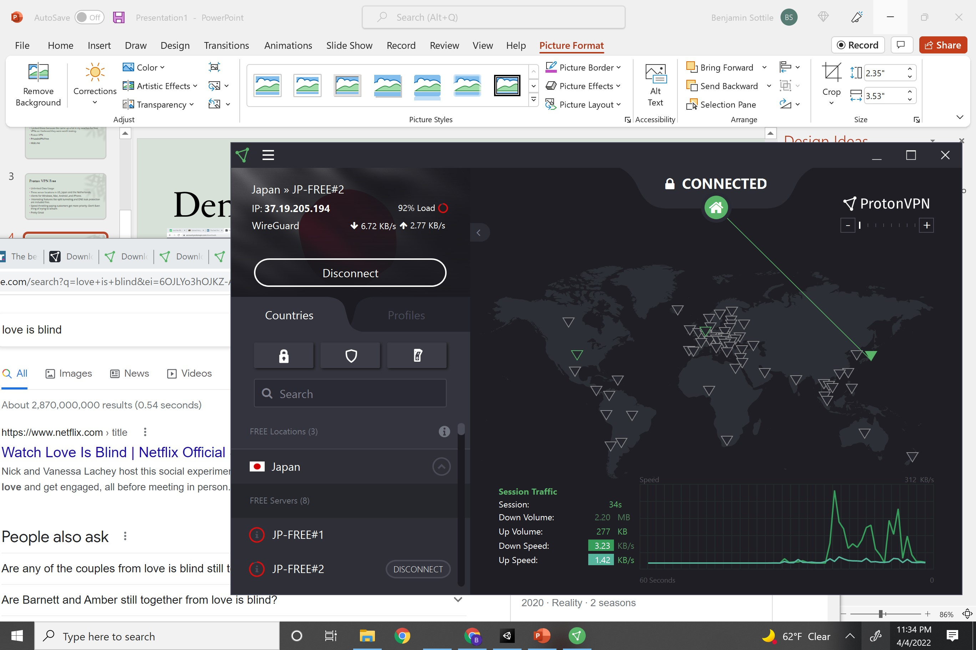
Demo

Slide 5
Hotspot Shield
500MB of data per day
Military-grade encryption
Super Friendly to use
Your limited to one US-based location that Hotspot Shield chooses for you
Pretty decent speeds

Slide 6
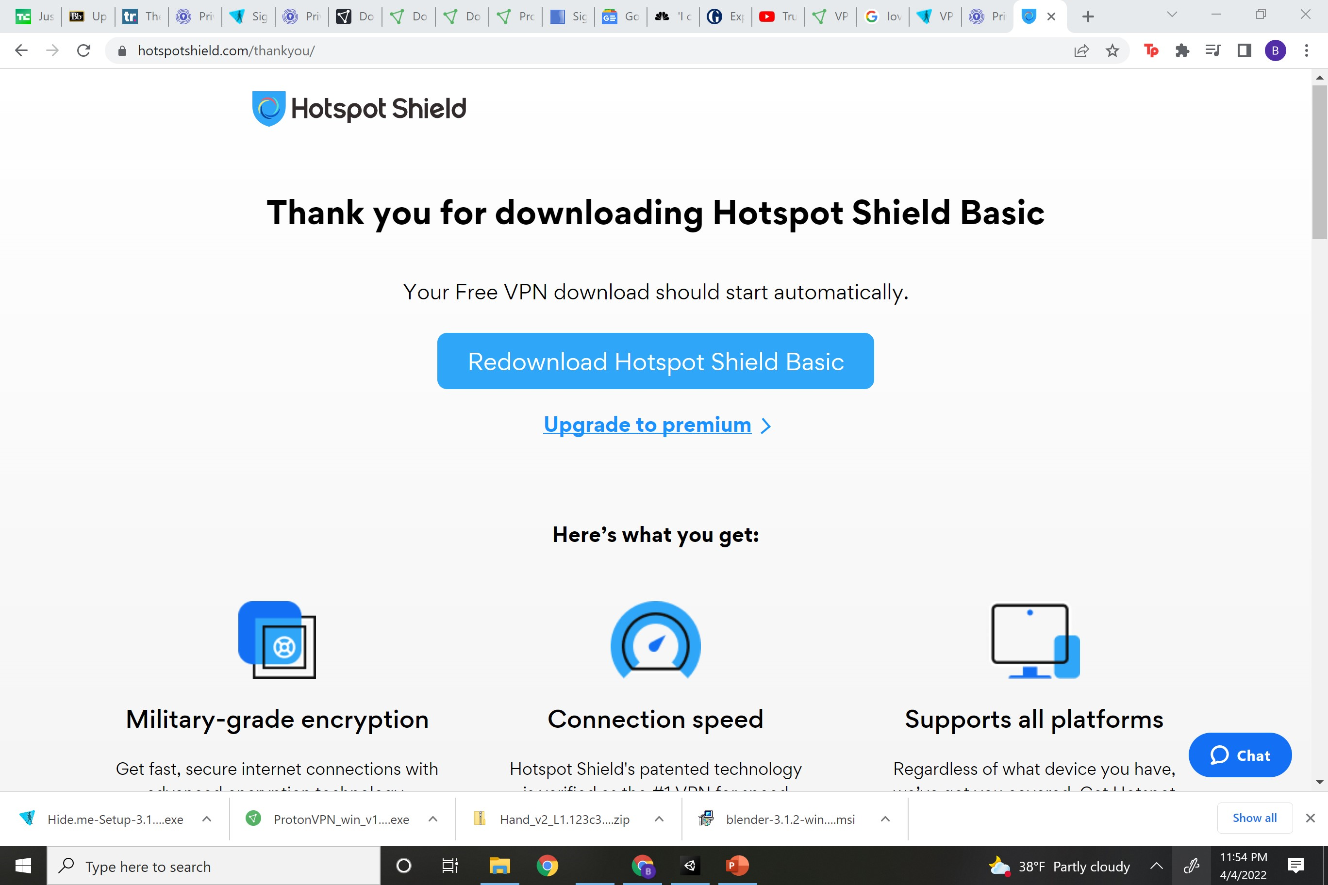
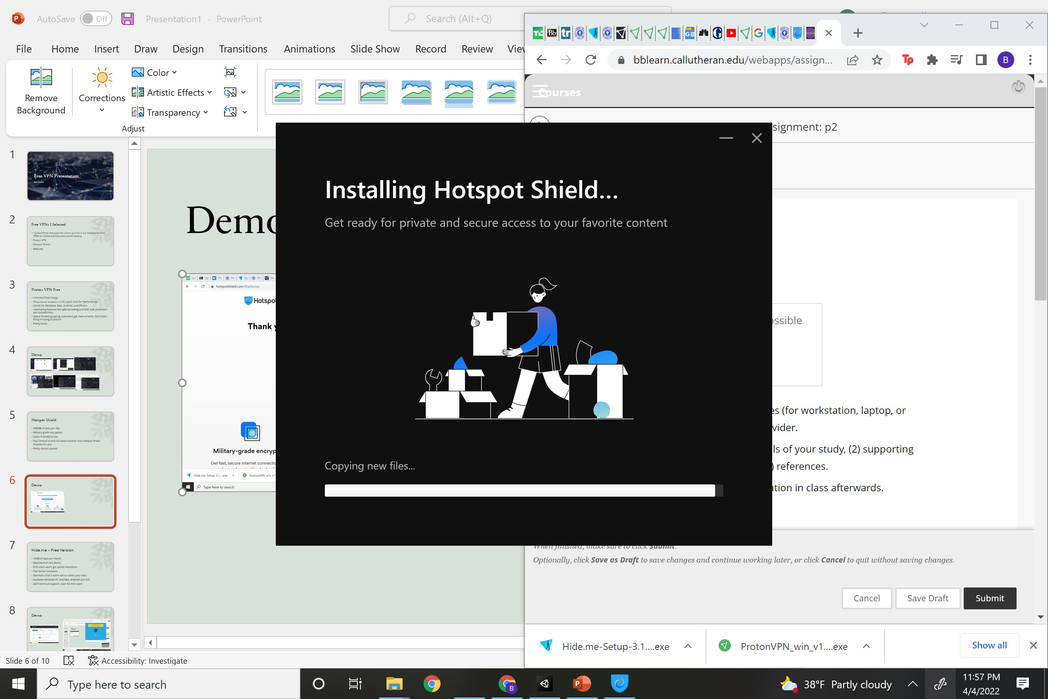
Demo

Slide 7
Hide.me – Free Version
10GB of data per month.
Maximum of one device
Free users won’t get speed reductions
Five Server Locations
Maintains that it won’t sell or collect your data
Available Windows PC and Mac, Android and iOS,
24/7 technical support- even for free users

Slide 8
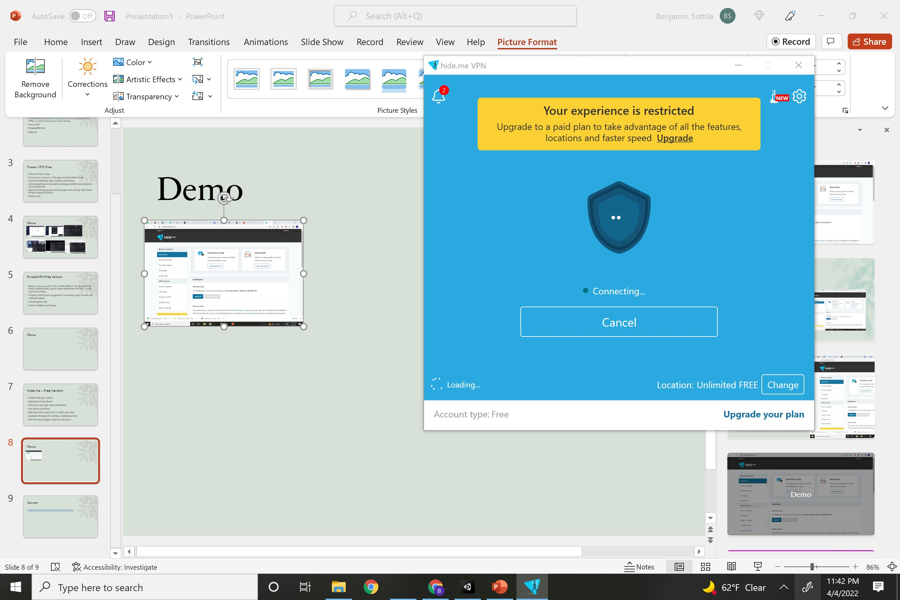
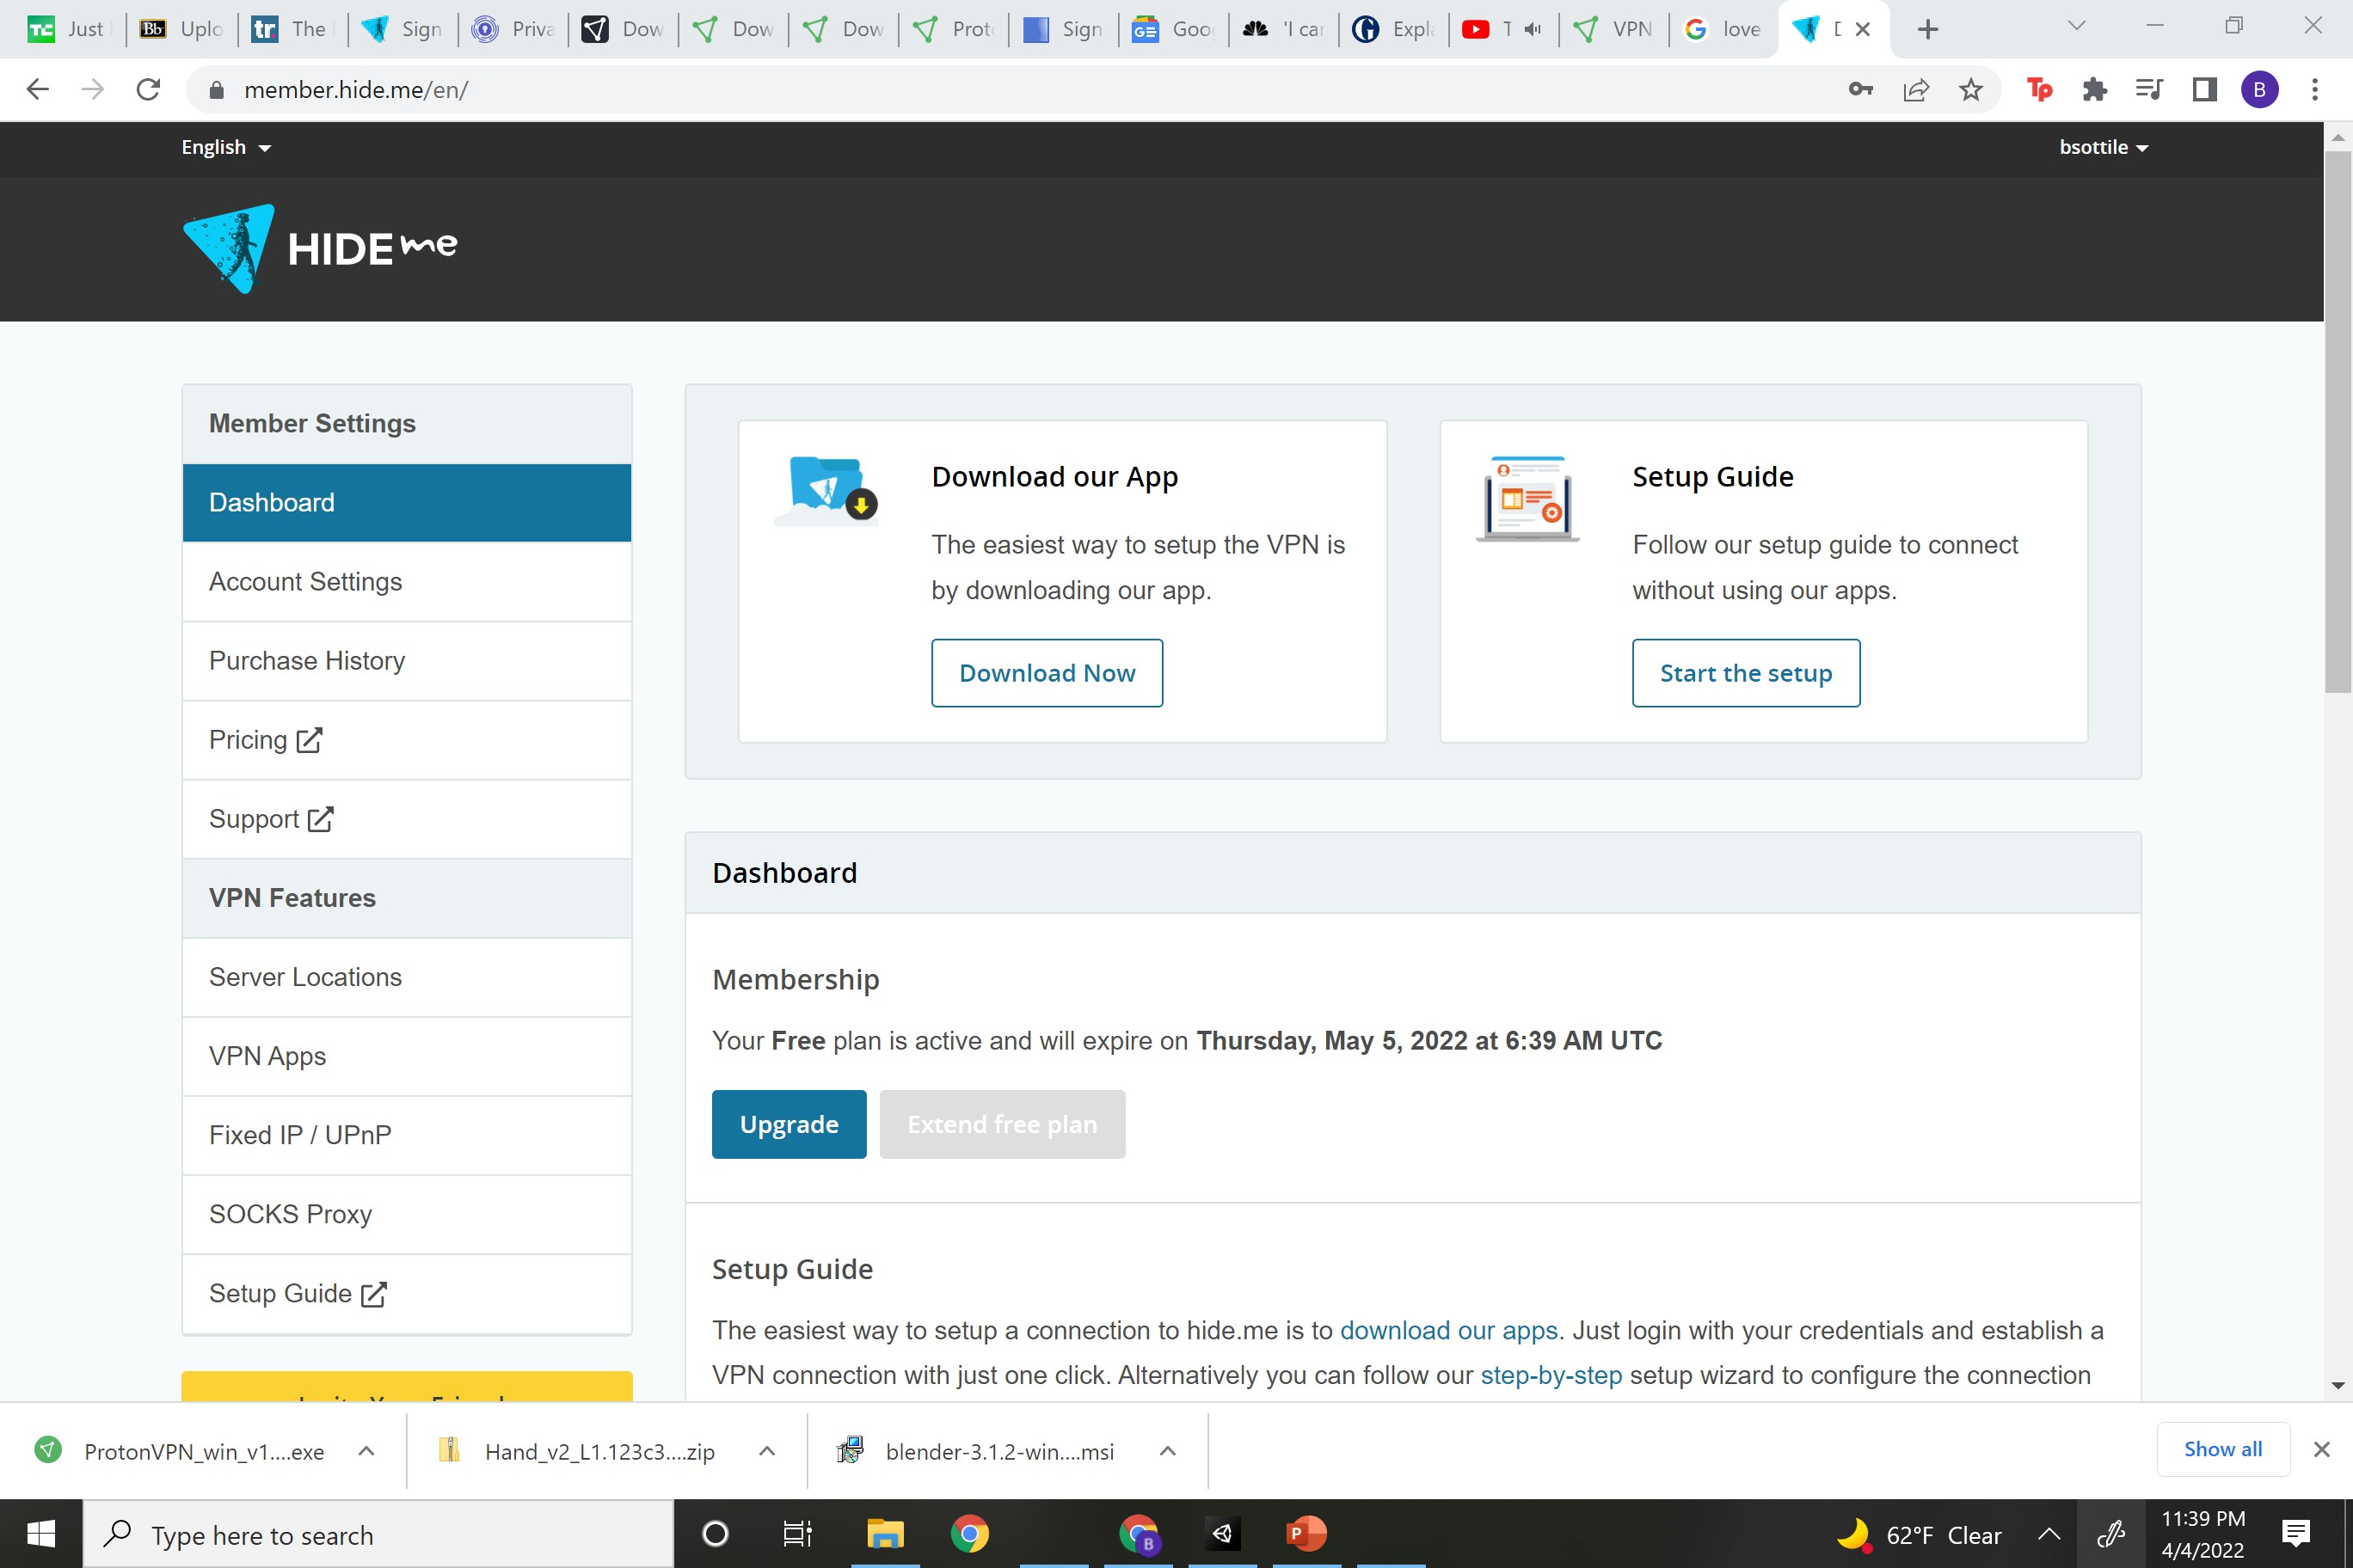
Demo

Slide 9
Sources
https://www.techradar.com/vpn/best-free-vpn

Slide 10
Provado Free
Ability to park yourself in US, Canada, Mexico, the UK, Germany, France, Netherlands, and its native Switzerland for free – > way more than Proton
Throws in P2P servers (so good for torrenters), auto connect and a VPN kill switch.
Streaming Friendly
Limit of 10GB every 30 days

